Slide 1
An Unusual Occultation….
or was it a Grazing Occultation ?

Slide 2
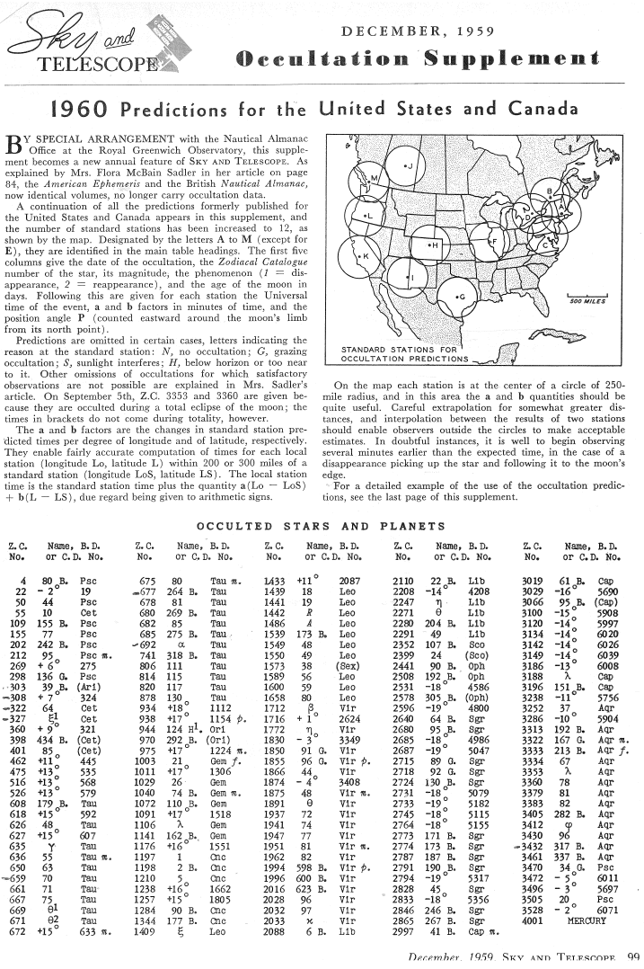
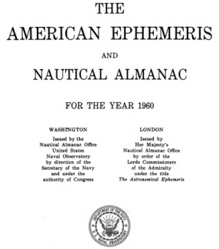

Slide 3
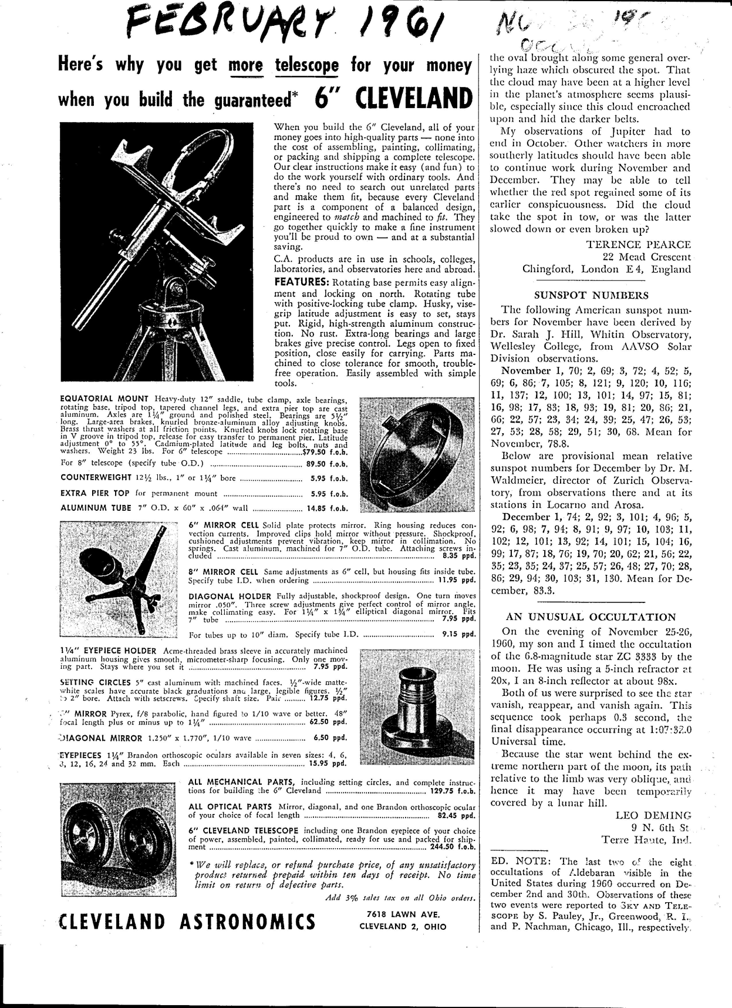

Slide 4
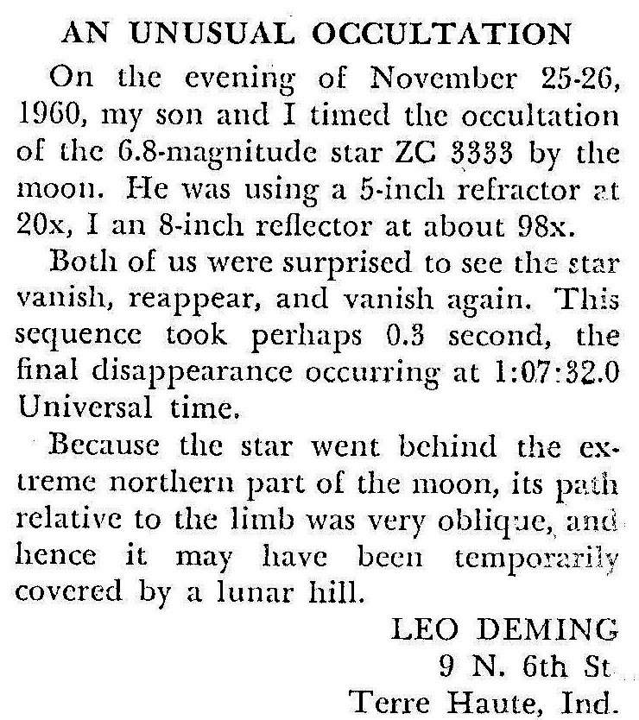

Slide 5
✰
✰

Slide 6
Let’s Investigate:
November 26, 1960 UT
Observed by Leo Deming and son
From Terre Haute, Indiana
Timed occultation of ZC 3333, m = +6.8
Leo Deming : 8″ reflector 98x
son : 5″ refractor 20x
Observed D R D in 0.3 sec
➔ D = 1:07:32 UT

Slide 7
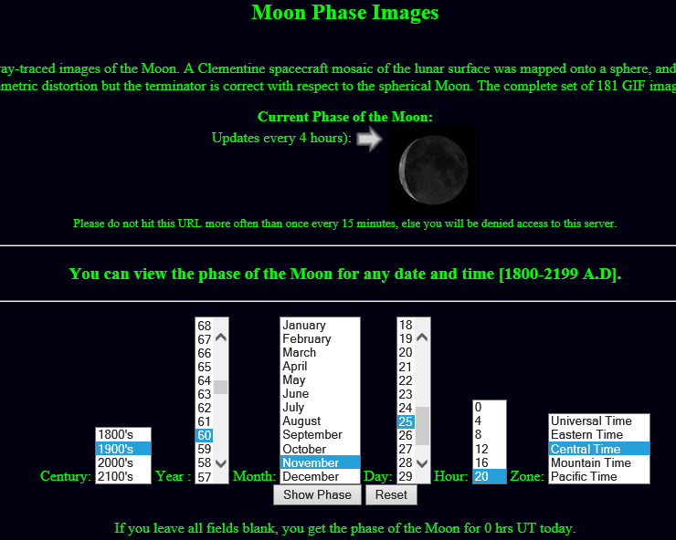

Slide 8
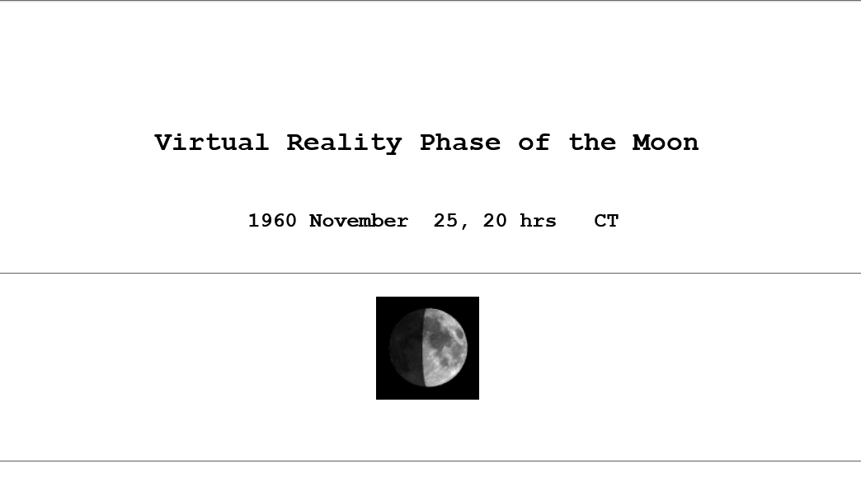

Slide 9
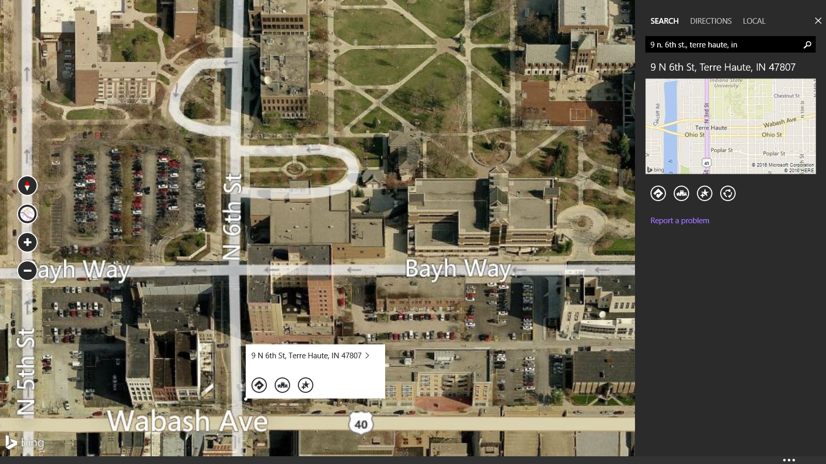
Az = 197°, Alt = 40°

Slide 10
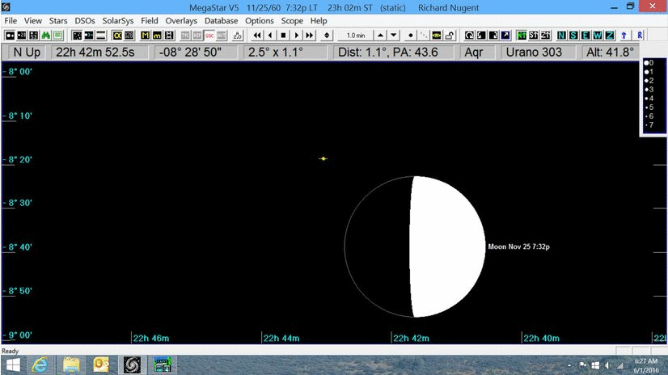

Slide 11
.

Slide 12
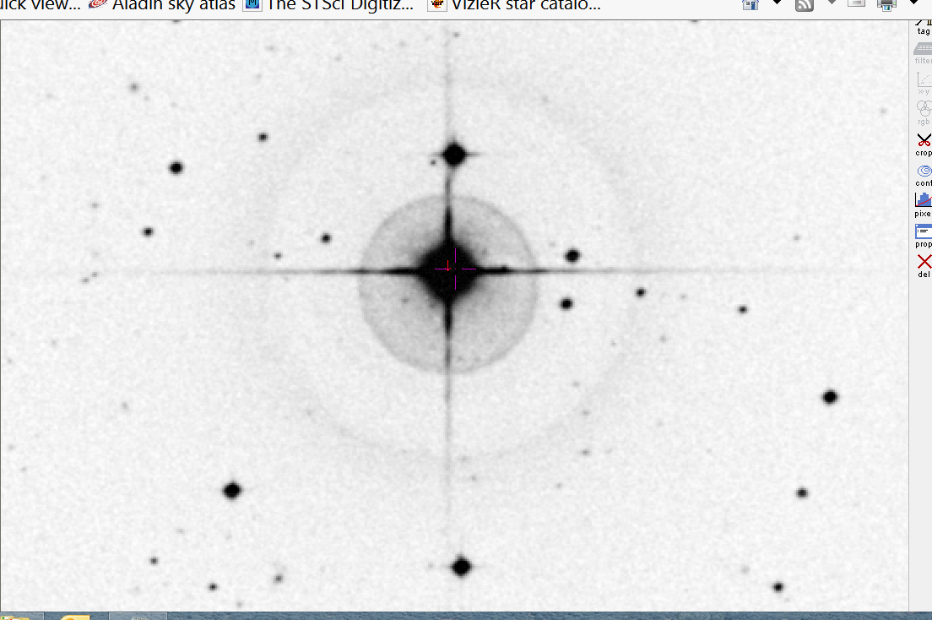
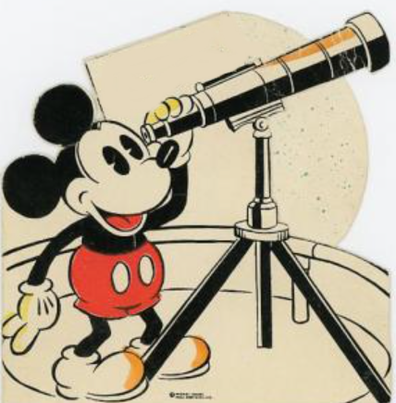
1 arc minute
N

Slide 13
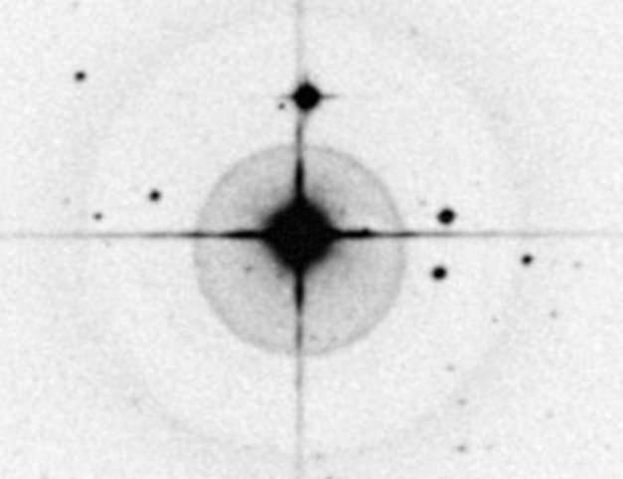

Slide 14
ZC 3333 is a multiple star !

Slide 15
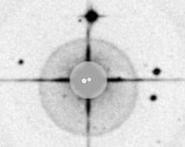
ZC 3333 data from the WDS:
STF2935 AB 1782 2012 108 311 306 3.0 2.4 6.79 7.88
STF2935 AC 1892 2000 9 358 357 70.0 70.1 6.79 11.37
STF2935 AD 1913 2000 7 277 277 77.2 74.4 6.79 14.17
Dates PA° Sep″ Mag
N
C
C
D
D
B
A

Slide 16
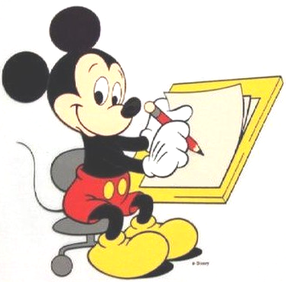
Deming & Son - - 1:07:32 UT
OCCULT - 1:07:26 UT, 6 seconds earlier
LOW - 1:07:33 UT, only 1.0 second later
★
Call
Dunham

Slide 17
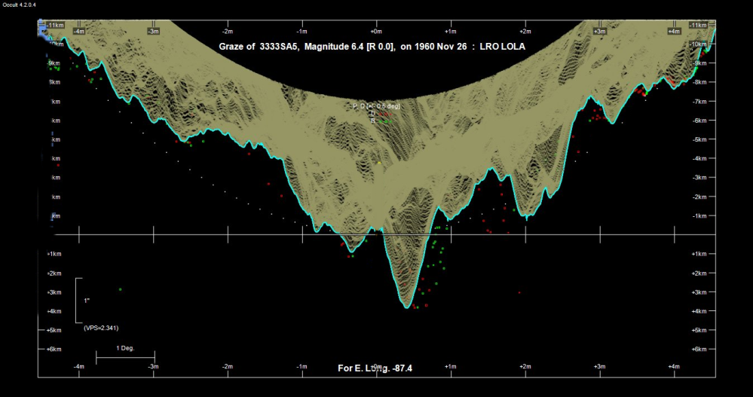

Slide 20
Sources of Error
Lunar theory – accuracy of Moon’s motion over 55 years
Location of Leo Deming & Son’s observation
Leo Deming’s timing method/accuracy

Slide 21
CONCLUSIONS
Leo Deming & Son did not see a grazing occultation
Leo Deming & Son observed a total occultation of a double star
Mystery
Solved !!

